Slide 1
ELECTRICAL SCIENCE-1 (15B11EC111) UNIT-3 Lecture-3
Dr. Abhishek Kashyap
Assistant Professor (Senior Grade, JIIT Noida)

Slide 2
Topics to be discussed
Thevenin equivalent circuit of a circuit having dependent and independent sources.
Thevenin equivalent circuit of a circuit having dependent sources only.
Problems.
Practice Problems
References

Slide 3
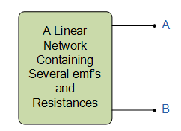
Thevenin equivalent circuit of a circuit having dependent and independent sources.
Procedure for solving such circuit using Thevenin’s Theorem
The calculation of Voc finding remain same as we have discussed for the circuits having independent sources only.
For R_{th} calculation, first calculate I_{sc} (short circuit current) by replacing the load resistance with short circuit. Then Rth can be obtained as:
Isc

Slide 4
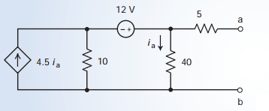
Problem 1
Q1. Determine the Thevenin equivalent circuit for the circuit shown in Figure.

Slide 5
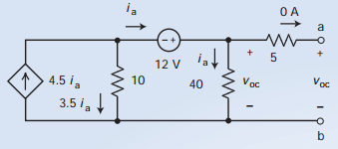
Solution 1
Sol. Step 1. Solving V_{oc}
The open circuit causes the current in the 5-V resistor to be zero. The voltage across that resistor is also zero, so the voltage across the 40-V resistor is voc . The i_{a} can be calculated as

Slide 6
Problem 1 continues
Applying KVL to the loop consisting the 12-V source, 10-Ω resistor, and 40- Ω resistor gives
by removing 40 ohm resistor as it is the item concerned

Slide 7
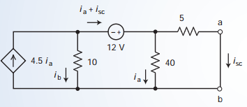
Problem 1 continues
Sol. Step 2. Solving Isc
Applying KVL in loop having 5 Ω and 40 Ω
resistors
Applying KCL at the top node of the 10 Ω resistor
Applying KVL in loop having 5 Ω and 10 Ω resistors

Slide 8
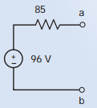
Problem 1 continues
Sol. Step 3. Solving Rth

Slide 9
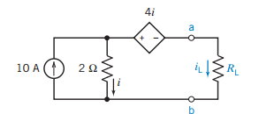
Problem 2
Q2. For the given circuit , find the value of the resistance R_{L} that will cause current i_{L} to be -2 A.

Slide 10
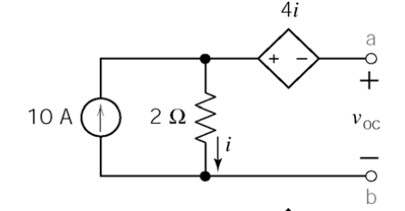
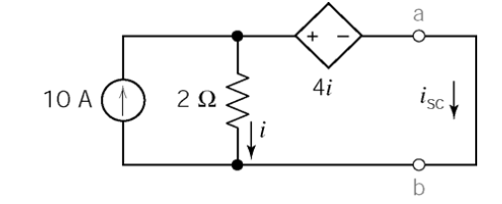
Solution 2

Slide 11
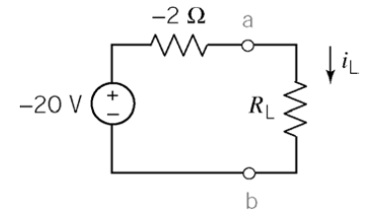
Problem 2 continues

Slide 12
Thevenin equivalent circuit of a circuit having dependent sources only.
Procedure for solving such circuit using Thevenin’s Theorem
The value of V_{oc} must be zero, because no independent source is there.
For R_{th} calculation, remove the load resistance and connects a 1 A current source across load terminals and measure the voltage V_{t} across that current source, then R_{th} is

Slide 13
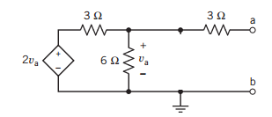
Problem 1
Q1. Determine the Thevenin's equivalent network for the given circuit.

Slide 14
Solution 1
V_{oc}=0
For R_{th},
+
Vt
-

Slide 15
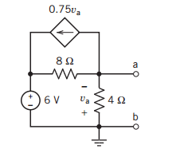
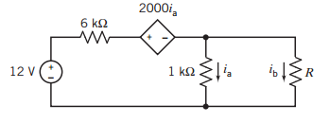
Practice Problems
Q1. Find the Thevenin equivalent circuit for the circuit shown in Figure .
Ans. Voc= -2V, Rth= -8/3 Ω
Q1. For the given circuit , find out the resistance R that will cause current ib to be 2 mA. The current ia has units of amps.
Ans. R=-2 Ω

Slide 16
References
[1]R.C. Dorf and James A. Svoboda, “Introduction to Electric Circuits”, 9th ed, John Wiley & Sons, 2013.

